Slide 1
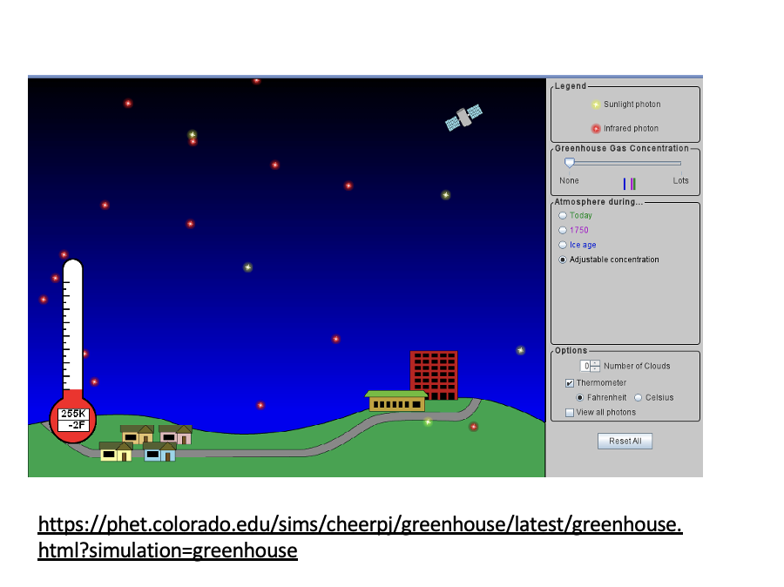
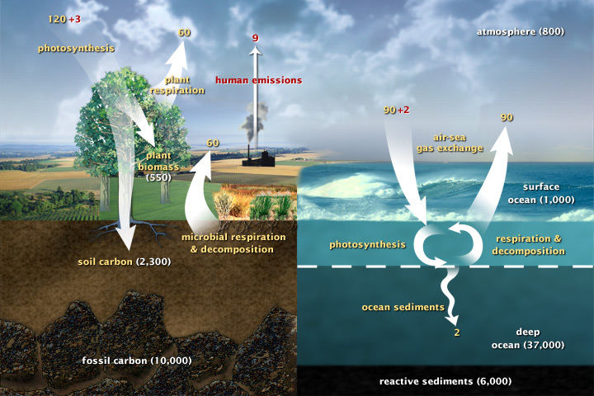
Homeostasis of a living planet
SW
LW
E.g., if Earth is too cold, net radiative flux is positive , so Earth will heat up!
Last week: Earth has mechanisms for correcting radiative imbalance → temperature homeostasis
E.g., if any of the three carbon reservoirs on Earth get too much, transfers (carbon fluxes) will kick in to offset it.
Next: Earth also has mechanisms for correcting carbon imbalances → carbon homeostasis

Slide 2
We’ll use the Houghton Carbon Balance (HCB) scheme to do get at this
https://science.nasa.gov/earth/earth-observatory/the-carbon-cycle/

Slide 3
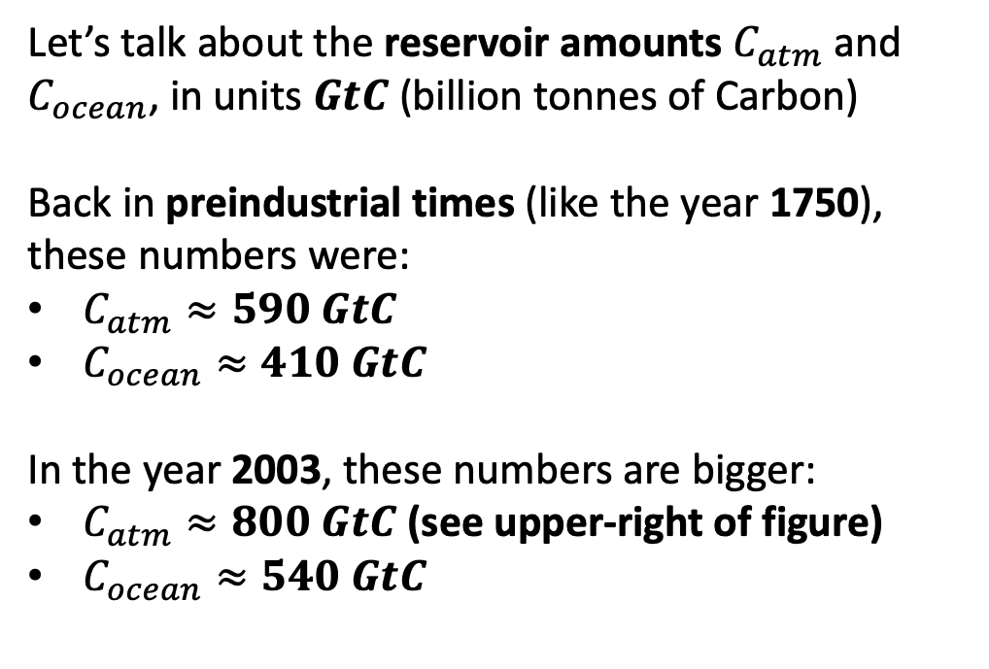
Reservoirs and reservoir amounts of carbon
Let’s talk about the reservoir amounts $C_{atm}$and $C_{ocean}$, in units $GtC$ (billion tonnes of Carbon)
Back in preindustrial times (like the year 1750), these numbers were:
$C_{atm}≈590 GtC$
$C_{ocean}≈410 GtC$
In the year 2003, these numbers are bigger:
$C_{atm}≈800 GtC$ (see upper-right of figure)
$C_{ocean}≈540 GtC$

Slide 4
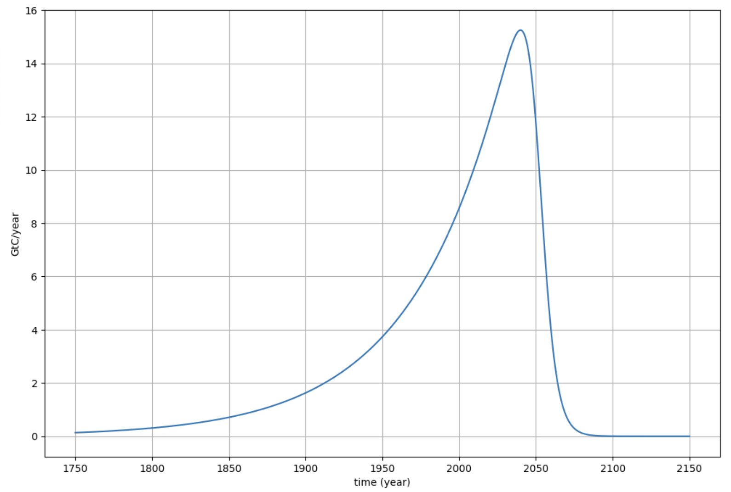
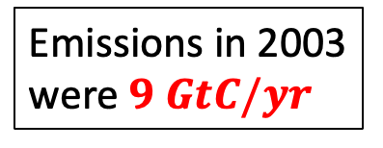
About that human emission flux …
Emissions in 2003 were $9 GtC/yr$
Preindustrial times, when we didn’t emit much carbon
Year 2003
A future when we don’t emit much carbon again

Slide 5
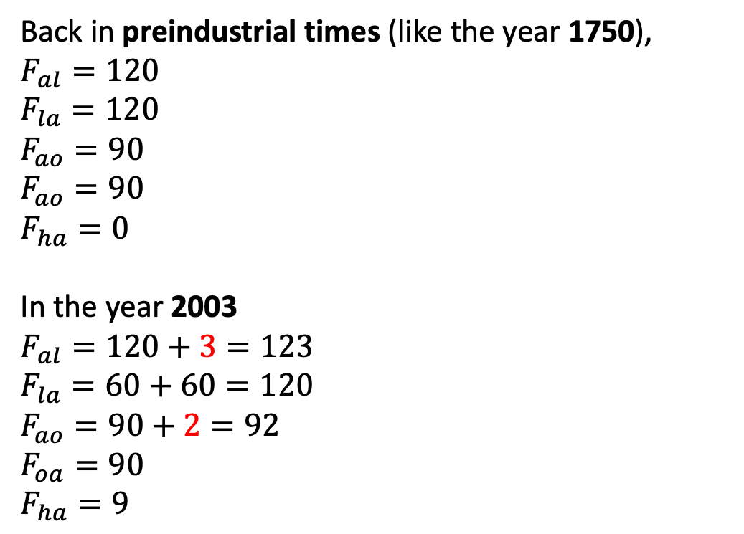
Now let’s talk about the fluxes (Units are $GtC/yr$)
Back in preindustrial times (like the year 1750),
$F_{al}=120$
$F_{la}=120$
$F_{ao}=90$
$F_{ao}=90$
$F_{ha}=0$
In the year 2003
$F_{al}=120+3=123$
$F_{la}=60+60=120$
$F_{ao}=90+2=92$
$F_{oa}=90$
$F_{ha}=9$
So …
Back in 1750, the carbon budget was in homeostasis (equal fluxes between reservoirs).
By 2003, the carbon budget was out of homeostasis because humans had been emitting carbon to the atmosphere for a long time (since 1750).

Slide 6
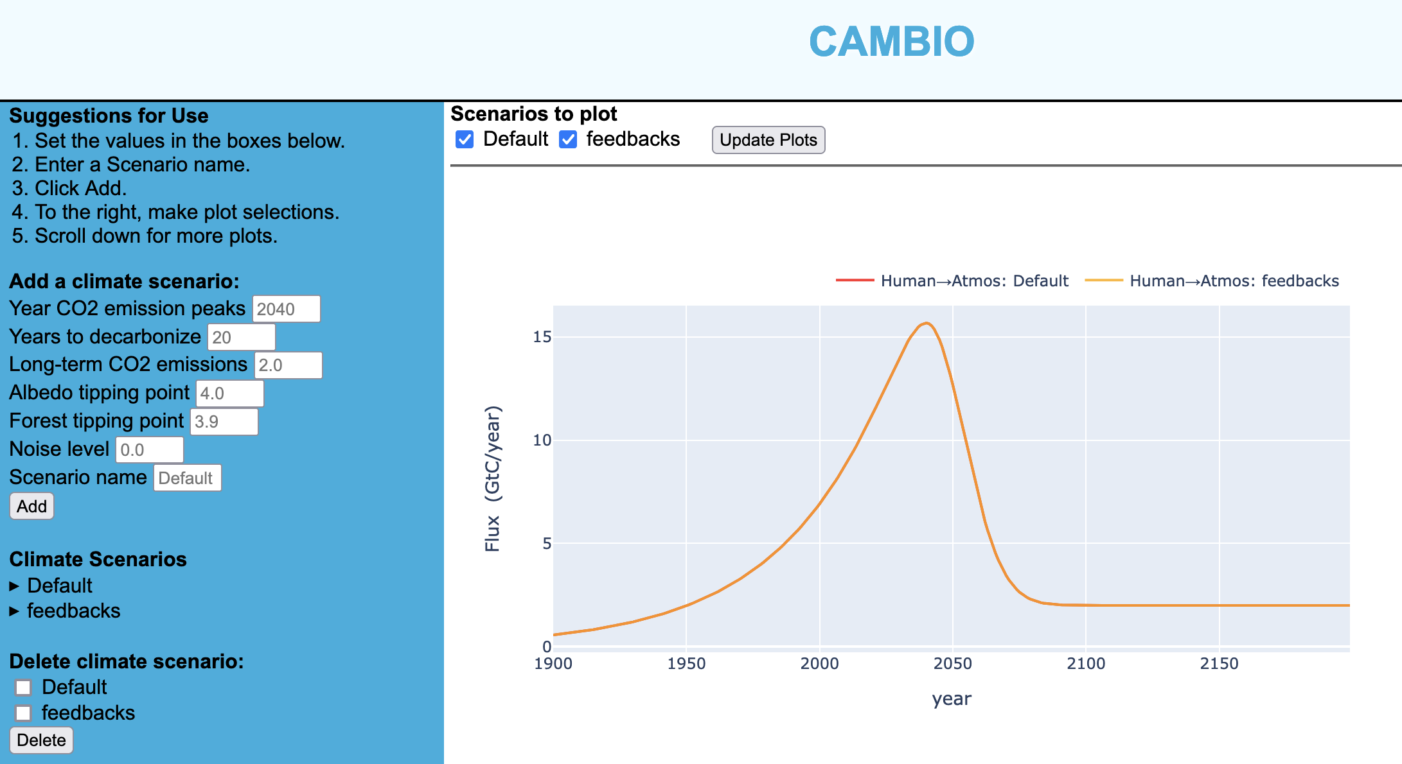
OK, let’s get started!
For the year 1900 (not quite preindustrial, but it’s as far as we can get on the web app):
What % of anthropogenic emission that year was sequestered by the land?
What % of anthropogenic emission was sequestered by the oceans?
For the year 2003 (the year of the HCB figure):
Is the anthropogenic emission in that year consistent with the HCB figure?
What % of anthropogenic emission that year was sequestered by the land?
What % of anthropogenic emission was sequestered by the oceans?
What’s the time delay between the year of maximum emission and the year of maximum CO2 in the atmosphere?
Formulate a hypothesis as to a mechanism for both forms of sequestration. If you have time, also formulate a hypothesis as to why there’s that time delay.
The web version of Cambio is at https://cambio.fly.dev/.

Slide 7
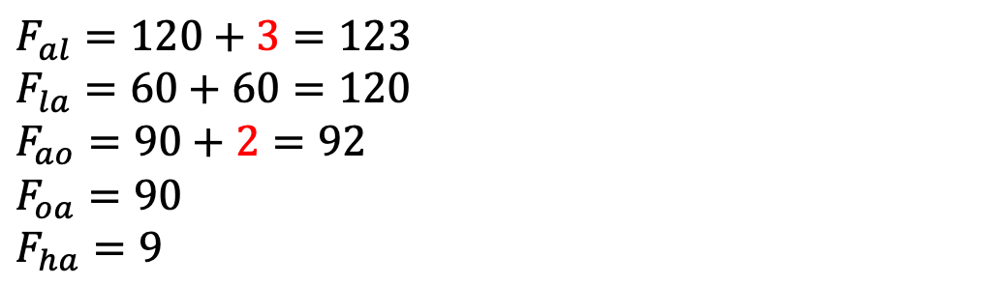

In the year 2003 … what percentage of human emissions were sequestered by the land?
$F_{al}=120+3=123$
$F_{la}=60+60=120$
$F_{ao}=90+2=92$
$F_{oa}=90$
$F_{ha}=9$
$\frac{3}{9}≈30\%$

Slide 8
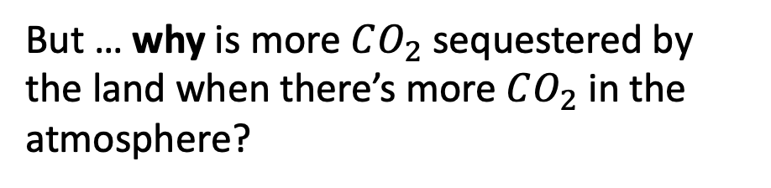
In the year 2003 … what percentage of human emissions were sequestered by the land?
$F_{al}=120+3=123$
$F_{la}=60+60=120$
$F_{ao}=90+2=92$
$F_{oa}=90$
$F_{ha}=9$
$\frac{3}{9}≈30\%$
But … why is more $CO_{2}$ sequestered by the land when there’s more $CO_{2}$ in the atmosphere?

Slide 9
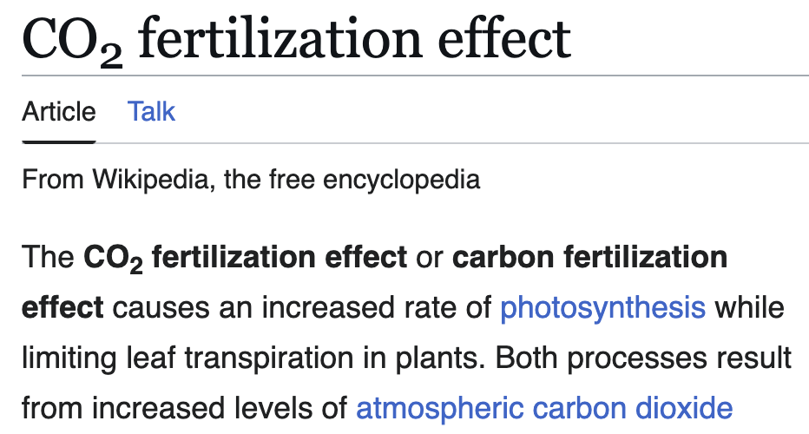
In the year 2003 … what percentage of human emissions were sequestered by the land?
$F_{al}=120+3=123$
$F_{la}=60+60=120$
$F_{ao}=90+2=92$
$F_{oa}=90$
$F_{ha}=9$
$\frac{3}{9}≈30\%$
But … why is more $CO_{2}$ sequestered by the land when there’s more $CO_{2}$ in the atmosphere?

Slide 10
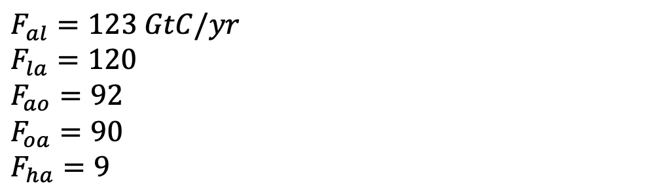
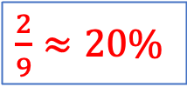
In the year 2003 … what percentage of human emissions were sequestered by the oceans?
$F_{al}=123 GtC/yr$
$F_{la}=120$
$F_{ao}=92$
$F_{oa}=90$
$F_{ha}=9$
$\frac{3}{9}≈30\%$
$\frac{2}{9}≈20\%$

Slide 11
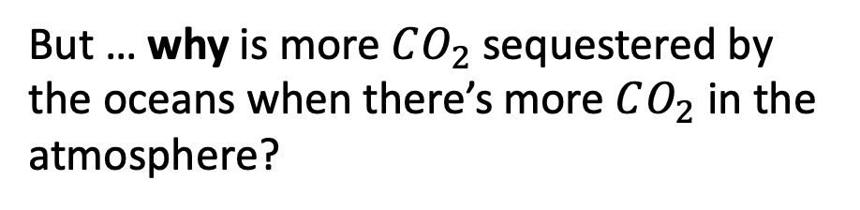
In the year 2003 … what percentage of human emissions were sequestered by the oceans?
$F_{al}=123 GtC/yr$
$F_{la}=120$
$F_{ao}=92$
$F_{oa}=90$
$F_{ha}=9$
$\frac{3}{9}≈30\%$
$\frac{2}{9}≈20\%$
But … why is more $CO_{2}$ sequestered by the oceans when there’s more $CO_{2}$ in the atmosphere?

Slide 12
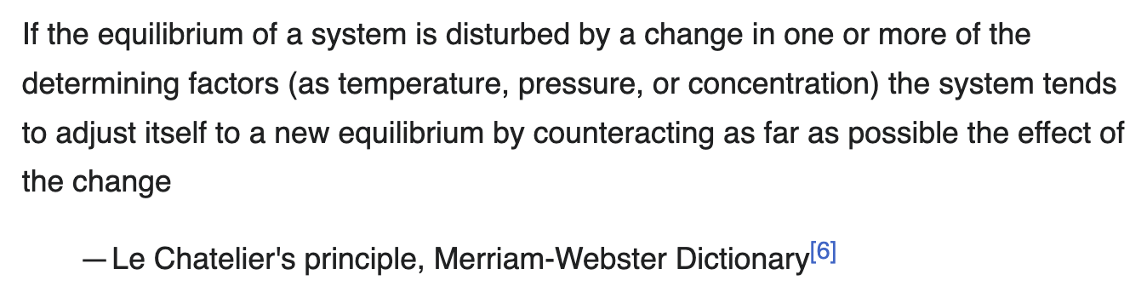
In the year 2003 … what percentage of human emissions were sequestered by the oceans?
$F_{al}=123 GtC/yr$
$F_{la}=120$
$F_{ao}=92$
$F_{oa}=90$
$F_{ha}=9$
$\frac{3}{9}≈30\%$
$\frac{2}{9}≈20\%$
But … why is more $CO_{2}$ sequestered by the oceans when there’s more $CO_{2}$ in the atmosphere?

Slide 13
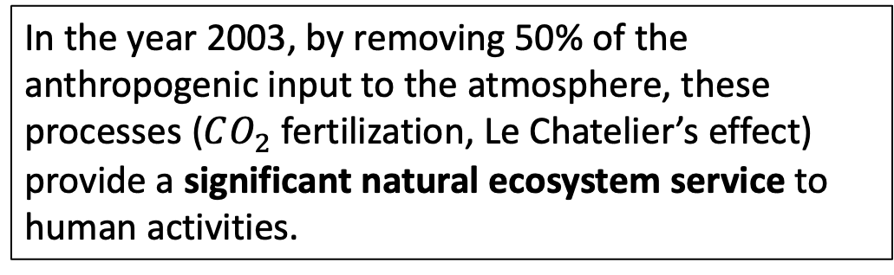
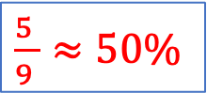
Combined effect of land AND oceans
$F_{al}=123 GtC/yr$
$F_{la}=120$
$F_{ao}=92$
$F_{oa}=90$
$F_{ha}=9$
$\frac{3}{9}≈30\%$
$\frac{5 }{9 }≈50\%$
$\frac{2}{9}≈20\%$
In the year 2003, by removing 50% of the anthropogenic input to the atmosphere, these processes ($CO_{2}$ fertilization, Le Chatelier’s effect) provide a significant natural ecosystem service to human activities.

Slide 14
Combined effect of land AND oceans
$F_{al}=123 GtC/yr$
$F_{la}=120$
$F_{ao}=92$
$F_{oa}=90$
$F_{ha}=9$
$\frac{3}{9}≈30\%$
$\frac{5 }{9 }≈50\%$
$\frac{2}{9}≈20\%$
In the year 2003, by removing 50% of the anthropogenic input to the atmosphere, these processes ($CO_{2}$ fertilization, Le Chatelier’s effect) provide a significant natural ecosystem service to human activities.
If those processes didn’t operate, global warming would happen twice as fast (i.e., we’d be at $+3℃$ warming right now instead of the $+1.5℃$ we’ve actually experienced).

Slide 15
Combined effect of land AND oceans
$F_{al}=123 GtC/yr$
$F_{la}=120$
$F_{ao}=92$
$F_{oa}=90$
$F_{ha}=9$
$\frac{3}{9}≈30\%$
$\frac{5 }{9 }≈50\%$
$\frac{2}{9}≈20\%$
In the year 2003, by removing 50% of the anthropogenic input to the atmosphere, these processes ($CO_{2}$ fertilization, Le Chatelier’s effect) provide a significant natural ecosystem service to human activities.
If those processes didn’t operate, global warming would happen twice as fast (i.e., we’d be at $+3℃$ warming right now instead of the $+1.5℃$ we’ve actually experienced).
Another way of saying this: the oceans, and a robustly photosynthesizing terrestrial biosphere, act as powerful negative (i.e., mitigating) feedbacks on the anthropogenic carbon budget.

Slide 16
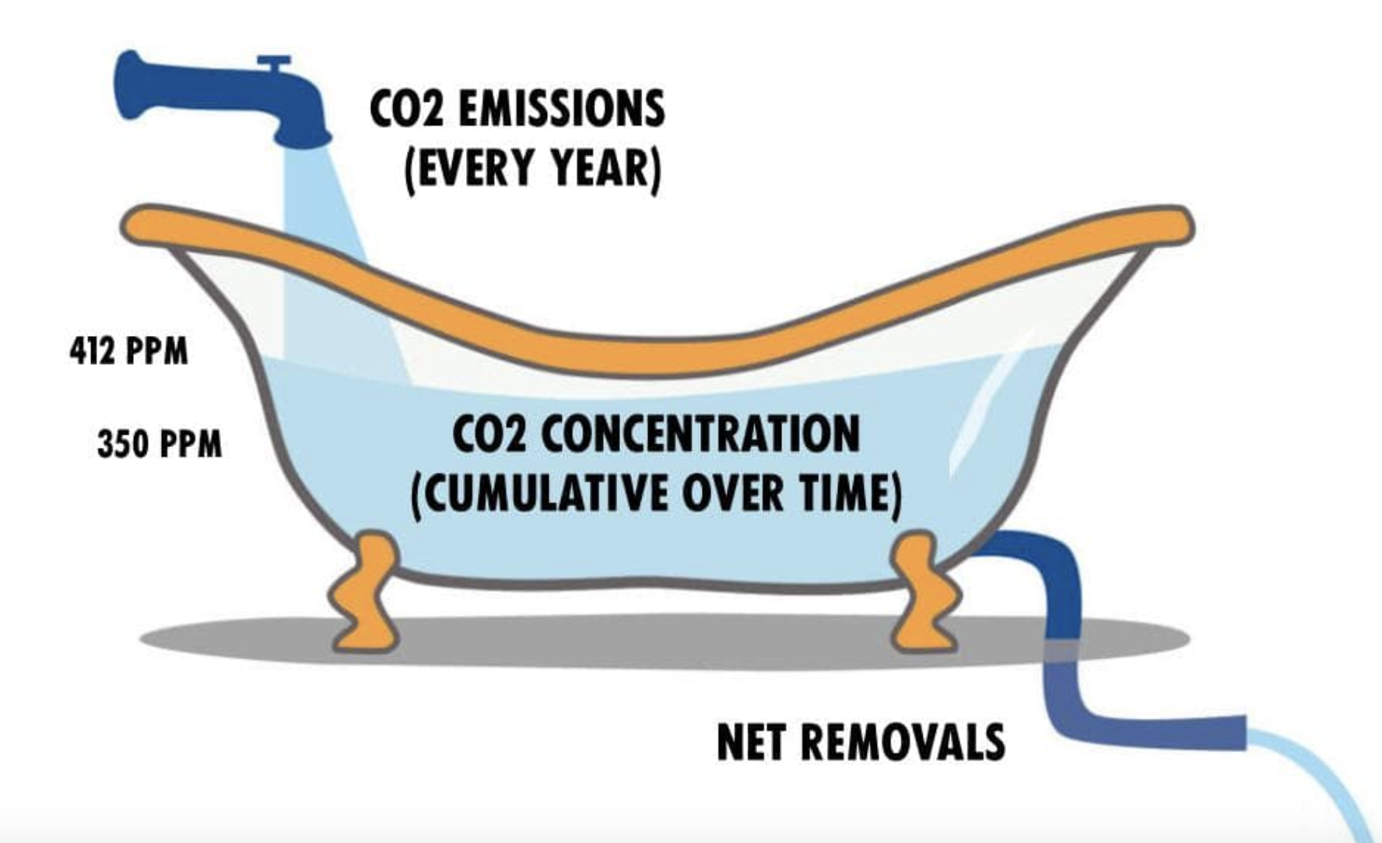
Why there’s that time delay

Slide 17
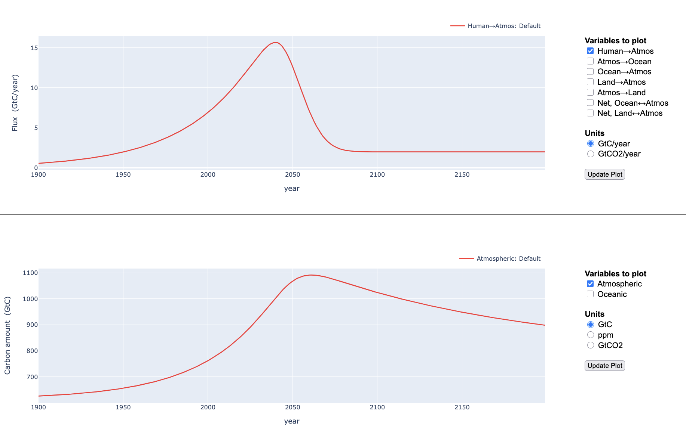
Why there’s that time delay

Slide 18
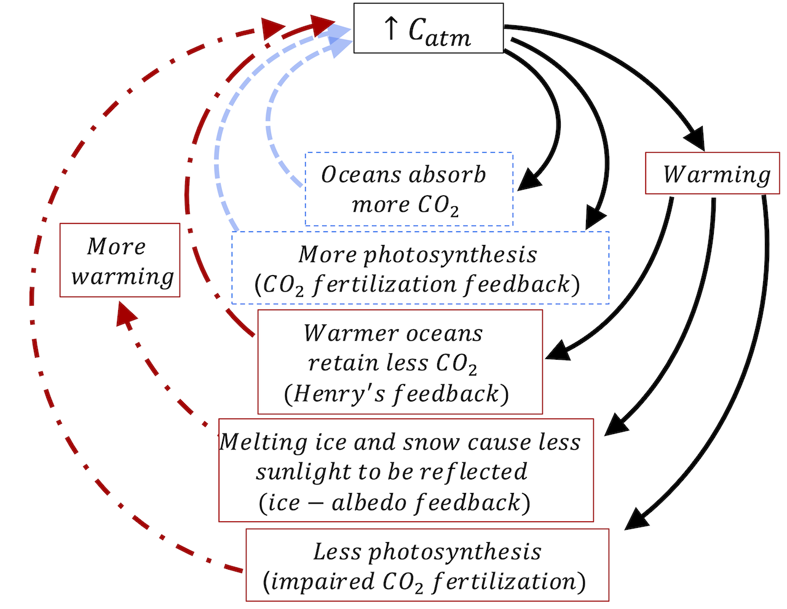
Negative feedbacks in a feedback diagram (shown with blue dashed lines)

Slide 19
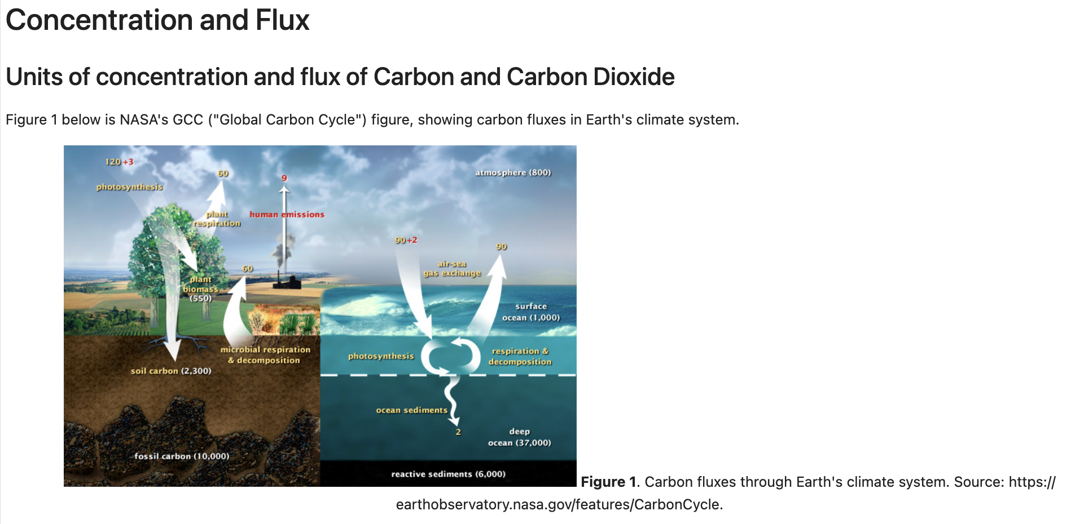
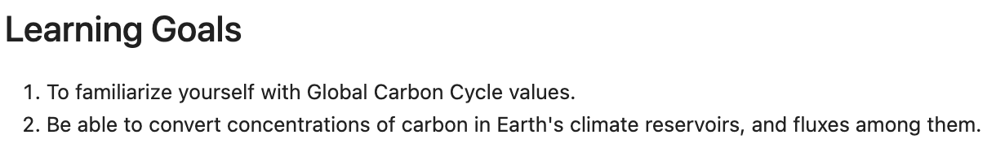
OK, let’s get started!
There’s also a short CGI, Week_03a.ConcentrationAndFlux, to help you get used to units.

